Slide 1
Genetic Algorithm
Iftekhar Mahmud Towhid

Slide 2
Genetic Algorithm
A genetic algorithm is a search heuristic that is inspired by Charles Darwin’s theory of natural evolution. This algorithm reflects the process of natural selection where the fittest individuals are selected for reproduction in order to produce offspring of the next generation.
It is used to solve optimization problems in machine learning. It is one of the important algorithms as it helps solve complex problems that would take a long time to solve.
Genetic Algorithms are being widely used in different real-world applications, for example, Designing electronic circuits, code-breaking, image processing, and artificial creativity.

Slide 3
Terminologies
Before understanding the Genetic algorithm, let's first understand basic terminologies to better understand this algorithm:
  Population: Population is the subset of all possible or probable solutions, which can solve the given problem.
  Chromosomes: A chromosome is one of the solutions in the population for the given problem, and the collection of gene generate a chromosome.
  Gene: A chromosome is divided into a different gene, or it is an element of the chromosome.
  Allele: Allele is the value provided to the gene within a particular chromosome.
  Fitness Function: The fitness function is used to determine the individual's fitness level in the population. It means the ability of an individual to compete with other individuals. In every iteration, individuals are evaluated based on their fitness function.
  Genetic Operators: In a genetic algorithm, the best individual mate to regenerate offspring better than parents. Here genetic operators play a role in changing the genetic composition of the next generation.

Slide 4
Selection
After calculating the fitness of every existent in the population, a selection process is used to determine which of the individualities in the population will get to reproduce and produce the seed that will form the coming generation.
Types of selection styles available
  Roulette wheel selection
  Event selection
  Rank- grounded selection
So, now we can define a genetic algorithm as a heuristic search algorithm to solve optimization problems. It is a subset of evolutionary algorithms, which is used in computing. A genetic algorithm uses genetic and natural selection concepts to solve optimization problems.

Slide 5
How Genetic Algorithm Work?
The genetic algorithm works on the evolutionary generational cycle to generate high-quality solutions. These algorithms use different operations that either enhance or replace the population to give an improved fit solution.
It basically involves five phases to solve the complex optimization problems, which are given as below:
  Initialization / Initial Population
  Fitness Function
  Selection
  Reproduction (Crossover and Mutation)
  Termination

Slide 6
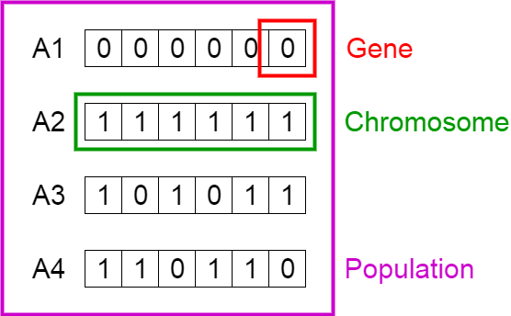
Initialization / Initial Population
The process begins with a set of individuals which is called a Population. Each individual is a solution to the problem you want to solve.
An individual is characterized by a set of parameters (variables) known as Genes. Genes are joined into a string to form a Chromosome (solution).
In a genetic algorithm, the set of genes of an individual is represented using a string, in terms of an alphabet. Usually, binary values are used (string of 1s and 0s). We say that we encode the genes in a chromosome.

Slide 7
Fitness Function
The fitness function determines how fit an individual is (the ability of an individual to compete with other individuals). It gives a fitness score to each individual. The probability that an individual will be selected for reproduction is based on its fitness score.

Slide 8
Selection
The idea of selection phase is to select the fittest individuals and let them pass their genes to the next generation.
Two pairs of individuals (parents) are selected based on their fitness scores. Individuals with high fitness have more chance to be selected for reproduction.

Slide 9
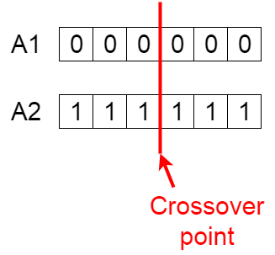
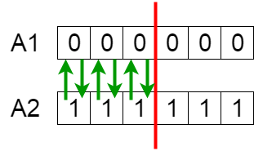
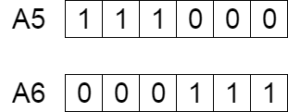
Crossover
Crossover is the most significant phase in a genetic algorithm. For each pair of parents to be mated, a crossover point is chosen at random from within the genes.
For example, consider the crossover point to be 3 as shown below.
Offspring are created by exchanging the genes of parents among themselves until the crossover point is reached.
The new offspring are added to the population.
Exchanging genes among parents
New offspring
Crossover point

Slide 10
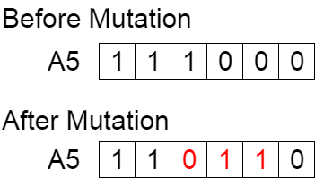
Mutation
In certain new offspring formed, some of their genes can be subjected to a mutation with a low random probability. This implies that some of the bits in the bit string can be flipped.
Mutation occurs to maintain diversity within the population and pre premature convergence.
Mutation: Before and After

Slide 11
Termination
The algorithm terminates if the population has converged (does not produce offspring which are significantly different from the previous generation). Then it is said that the genetic algorithm has provided a set of solutions to our problem.

Slide 12
Details on Selection
There are many different strategies to select the individuals to be copied over into the next generation

Slide 13
Methods of Selection
Roulette-wheel selection.
Elitist selection.
Fitness-proportionate selection.
Scaling selection.
Rank selection.

Slide 14
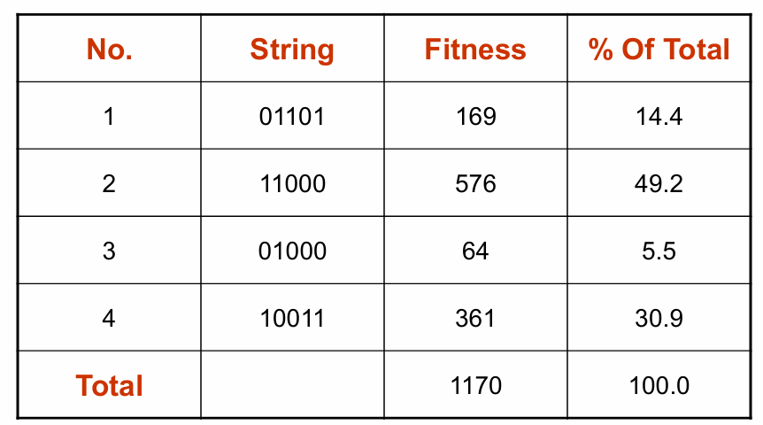
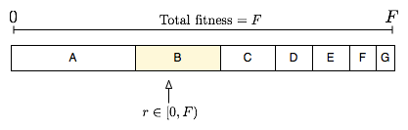
Roulette-wheel selection
Fitness proportionate selection, also known as roulette wheel selection, is a genetic operator used in genetic algorithms for selecting potentially useful solutions for recombination.
Conceptually, this can be represented as a game of roulette - each individual gets a slice of the wheel, but more fit ones get larger slices than less fit ones.

Slide 15

Roulette-wheel selection
In fitness proportionate selection, as in all selection methods, the fitness function assigns a fitness to possible solutions or chromosomes. This fitness level is used to associate a probability of selection with each individual chromosome. If f_{i} is the fitness of individual i in the population, its probability of being selected is –
where N is the number of individuals in the population.

Slide 16
Other selection methods
Elitist selection:
  Chose only the most fit members of each generation.
Cutoff selection:
  Select only those that are above a certain cutoff for the target function.

Slide 17
Crossover Strategies
Types of crossover styles available:
  Single / One point crossover
  Two-point / N-point crossover
  Uniform crossover

Slide 18
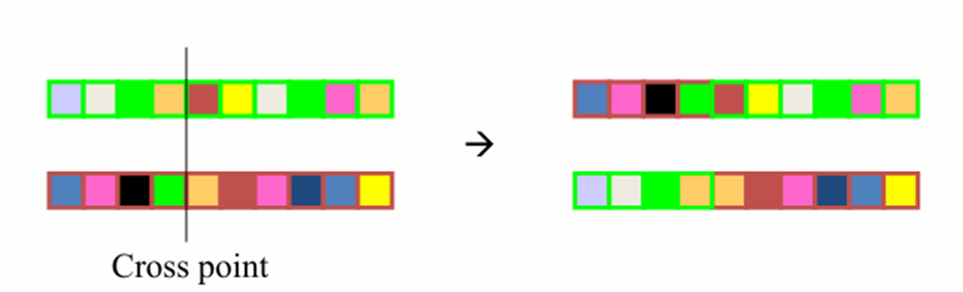
Single Point Crossover
A crossover point on the parent organism string is selected. All data beyond that point in the organism string is swapped between the two parent organisms. Strings are characterized by Positional Bias.

Slide 19
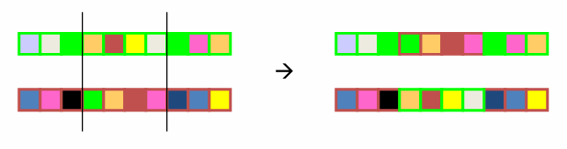
Two-Point Crossover
This is a specific case of a N-point Crossover technique. Two random points are chosen on the individual chromosomes (strings) and the genetic material is exchanged at these points.

Slide 20
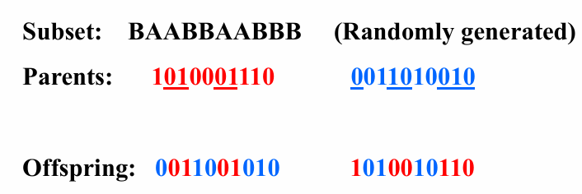
Uniform Crossover
Each gene (bit) is selected randomly from one of the corresponding genes of the parent chromosomes.
Use tossing of a coin as an example technique.

Slide 21
GA Example (The MAXONE Problem)
the MAXONE problem:
Suppose we want to maximize the number of ones in a string of l binary digits
  Is it a trivial problem?
  It may seem so because we know the answer in advance
However, we can think of it as maximizing the number of correct answers, each encoded by 1, to l yes/no difficult questions

Slide 22
The MAXONE Problem
The MAXONE problem is a trivial problem often used to introduce the concept of genetic algorithms. It’s incredibly simple, but it’s great for introducing many of the critical aspects of a genetic algorithm. The problem boils down to one question: what is the maximum sum of a bitstring (a string consisting of only 1s and 0s) of length N?
Of course, you know that the maximum sum of a bitstring of length N is N. However, if you wanted to prove this using a brute-force search, you’d end up needing to search through 2^{N} different solutions. As with any search problem, this isn’t too difficult with relatively small bitstrings. But what happens if you want to use this technique for bitstrings of length 40? You’d have to search over one trillion possible bitstrings. To avoid this, you’ll create a genetic algorithm that produces an optimal solution without iterating over every possible solution in the search space.

Slide 23
GA Implementation
Common representation methods
  Binary strings.
  Arrays of integers (usually bound)
  Arrays of letters
  …
For solving MAXONE Problem, we will use the Binary String representation.

Slide 24
GA Solution of MAXONE Problem
Encoding:
  An individual is encoded (naturally) as a string of l binary digits
Fitness Function:
  The fitness f of a candidate solution to the MAXONE problem is the number of ones in its genetic code
Initialization:
  We start with a population of n random strings. Suppose that l = 10 and n = 6

Slide 25
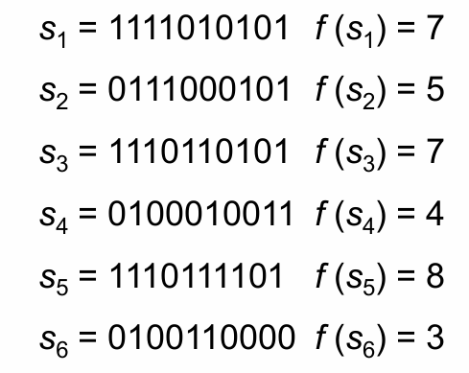
MAXONE: Initialization
We toss a fair coin 60 times and get the following initial population:

Slide 26
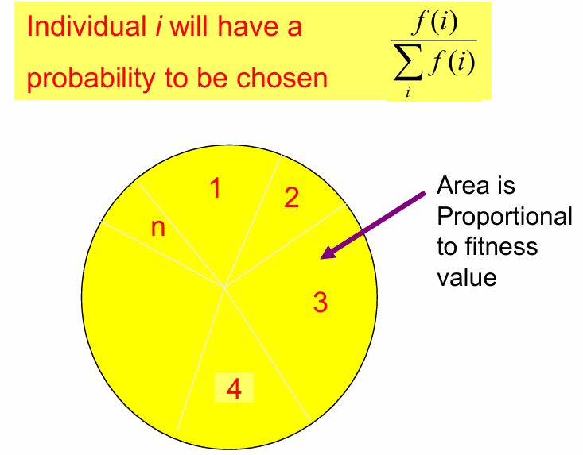
Step 1: Selection
We randomly (using a biased coin) select a subset of the individuals based on their fitness:

Slide 27
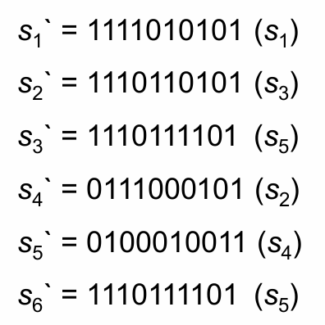
Selected set
Suppose that, after performing selection, we get the following population:

Slide 28
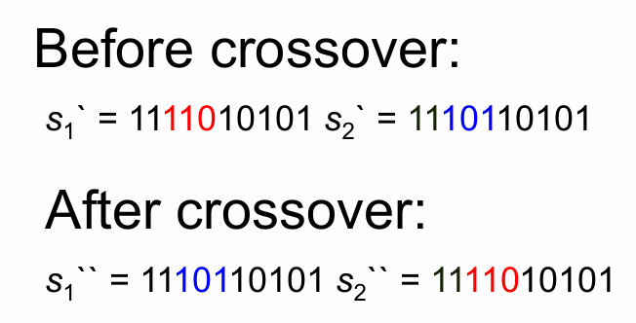
Step 2: crossover
Next, we mate strings for crossover. For each couple we first decide (using some pre-defined probability, for instance 0.6) whether to actually perform the crossover or not
If we decide to actually perform crossover, we randomly extract the crossover points, for instance 2 and 5

Slide 29
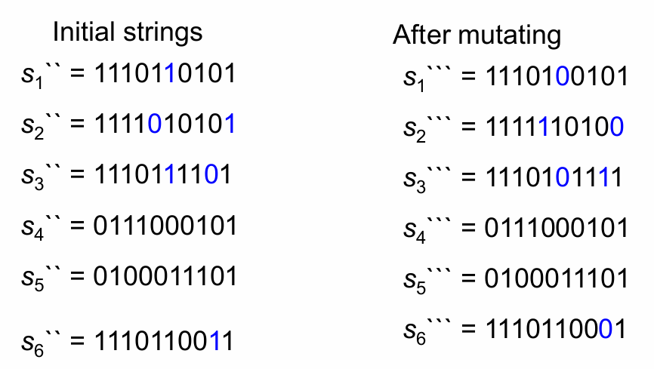
Step 3: mutations
The final step is to apply random mutations: for each bit that we are to copy to the new population we allow a small probability of error (for instance 0.1)

Slide 30
Iteration and Termination
In one generation, the total population fitness changed from 34 to 37, thus improved by ~9%
At this point, we go through the same process all over again, until a stopping criterion is met

Slide 31
Travelling Salesman Problem
The Traveling Salesman Problem:
Find a tour of a given set of cities so that
  each city is visited only once
  the total distance traveled is minimize

Slide 32
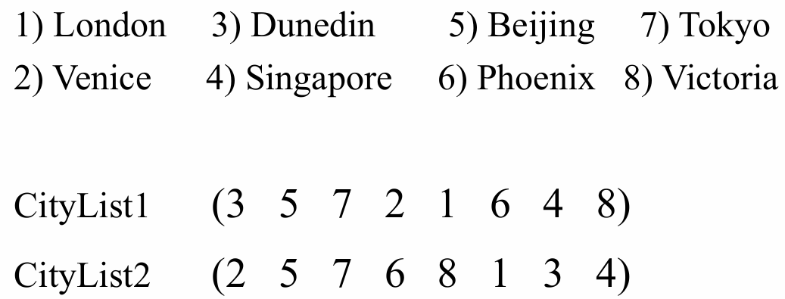
Representation
Representation is an ordered list of city numbers known as an order-based GA.

Slide 33
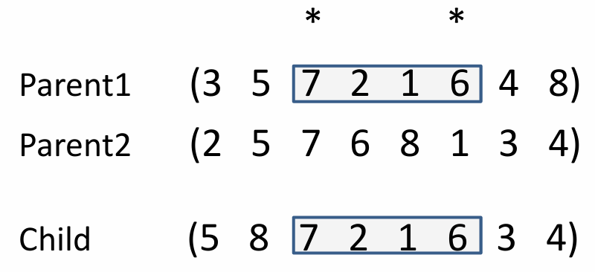
Crossover
Crossover combines inversion and recombination:
This operator is called the Order1 crossover.

Slide 34
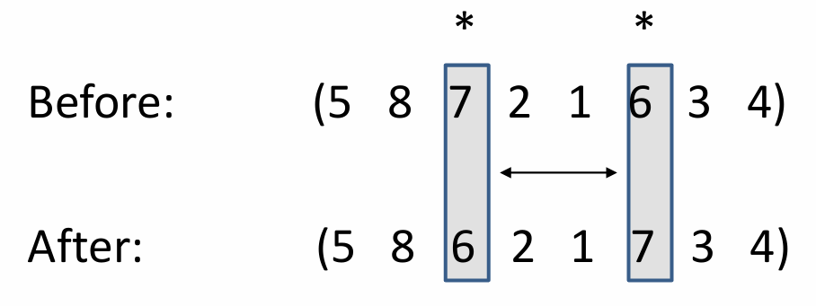
Mutation
Mutation involves reordering of the list:

Slide 35
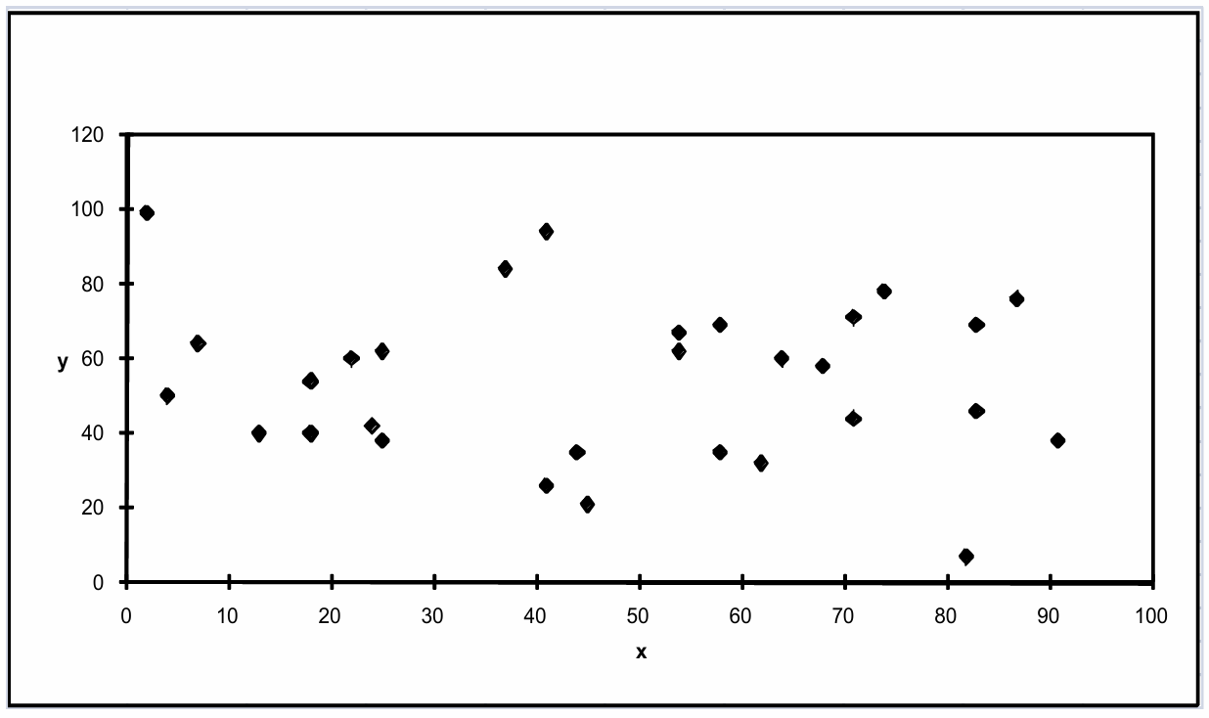
TSP Example: 30 Cities

Slide 36
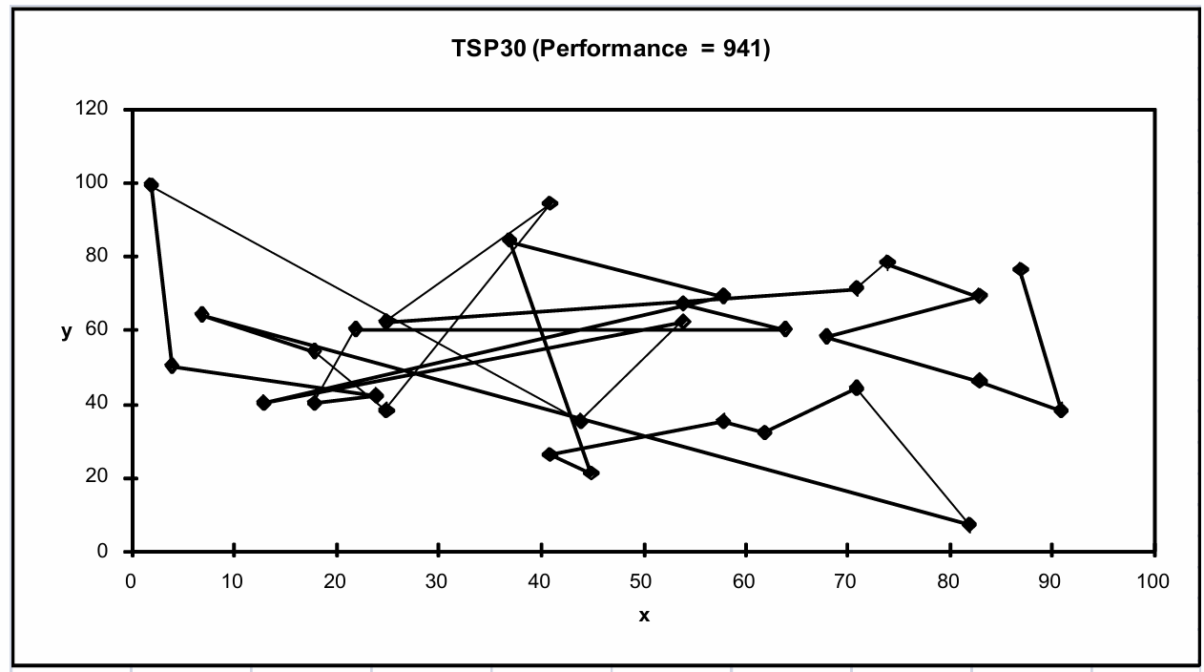
Solution_{i} (Distance = 941)

Slide 37
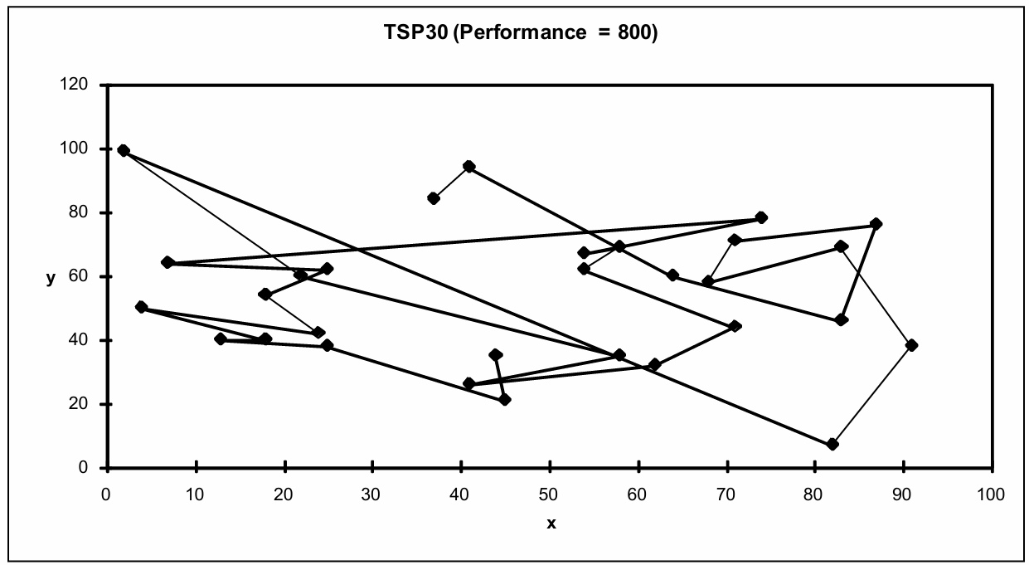
Solution_{j} (Distance = 800)

Slide 38
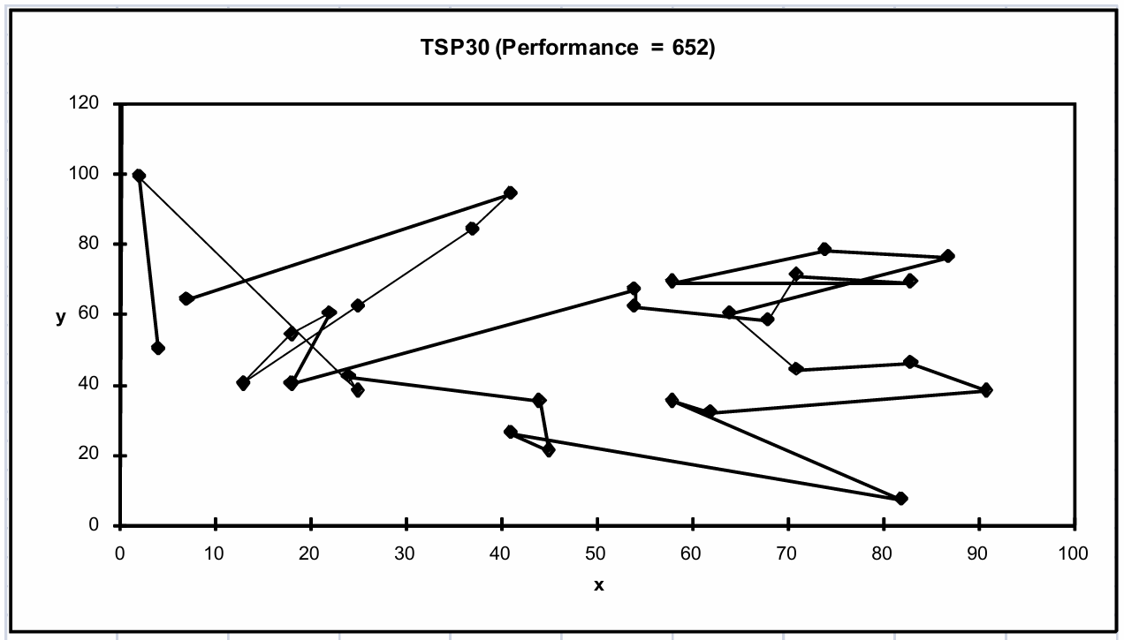
Solution_{k} (Distance = 652)

Slide 39
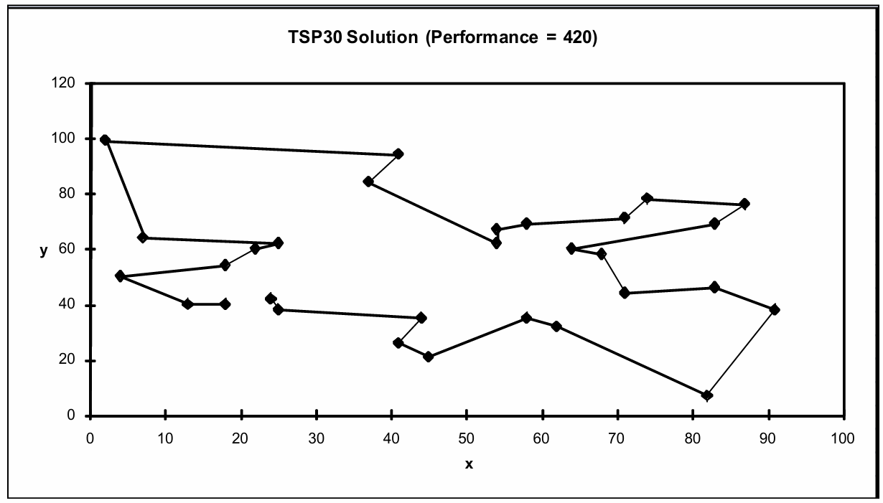
Best Solution (Distance = 420)

Slide 40
GA Applications
Domain | Application Type
Control | Gas pipeline, missile evasion
Design | Aircraft design, keyboard configuration, communication networks
Game playing | Poker, checkers
Security | Encryption and Decryption
Robotics | Trajectory planning

Slide 41
Benefits of Genetic Algorithms
Concept is easy to understand
Modular, separate from application
Supports multi-objective optimization
Always an answer; answer gets better with time.
Easy to exploit previous or alternate solutions
Flexible building blocks for hybrid applications.

